Slide 1
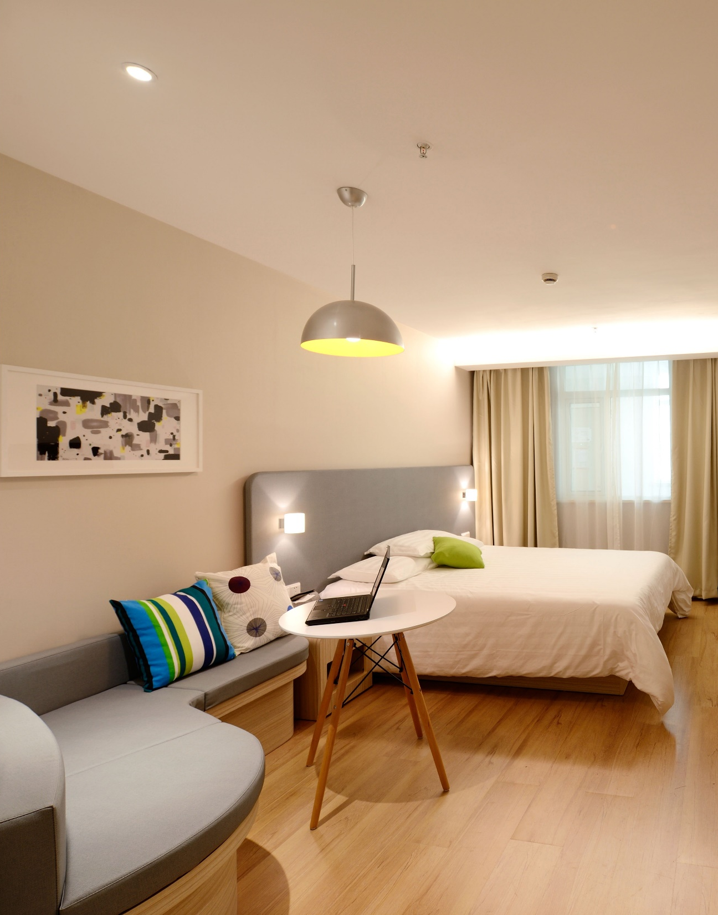

Barcelona listings
Berta Pla i Casamitjana, Fèlix Real Fraxedas

Slide 2

9 character
The dataset
11 factor
Airbnb listings in Barcelona
9,502 observations
14 integer
15 numeric

Slide 3
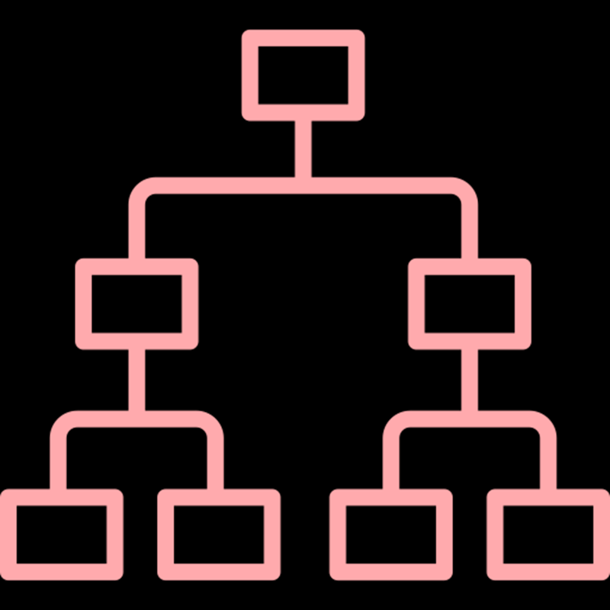


Unsupervised clustering
Using a subset of 1,000 observations and all the numerical and factor variables:
Hierarchical clustering
K-Means
3 clusters
3 clusters

Slide 4
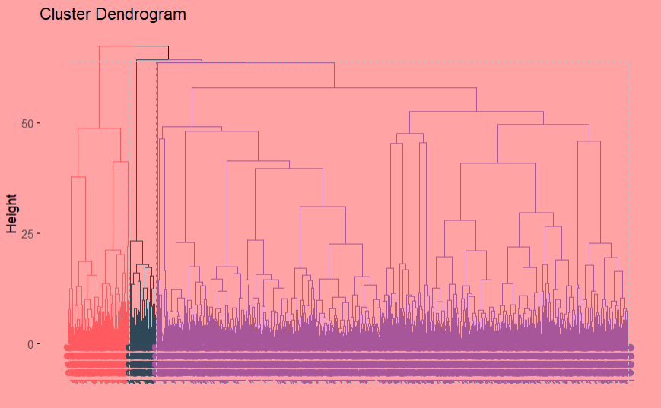
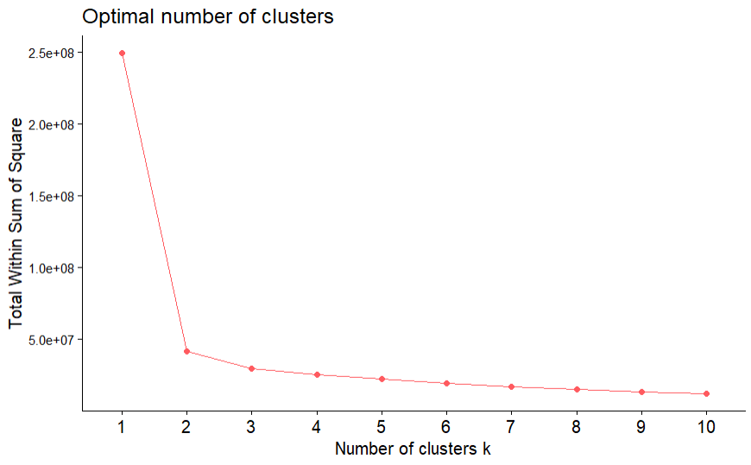
Hierarchical clustering

Slide 5
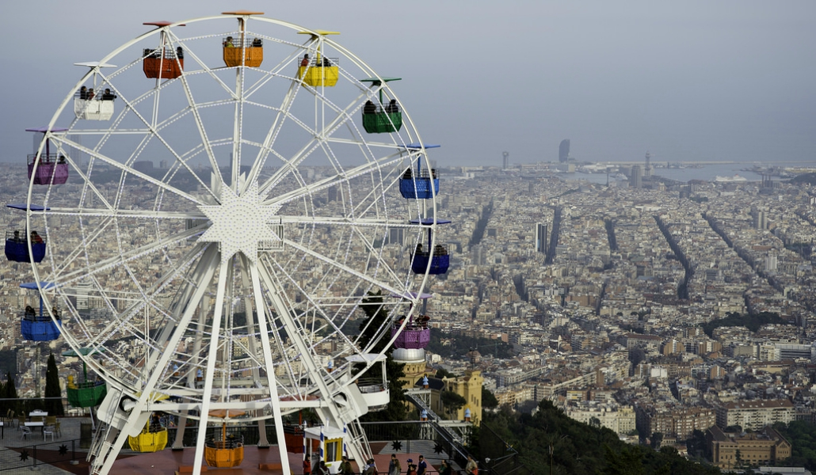
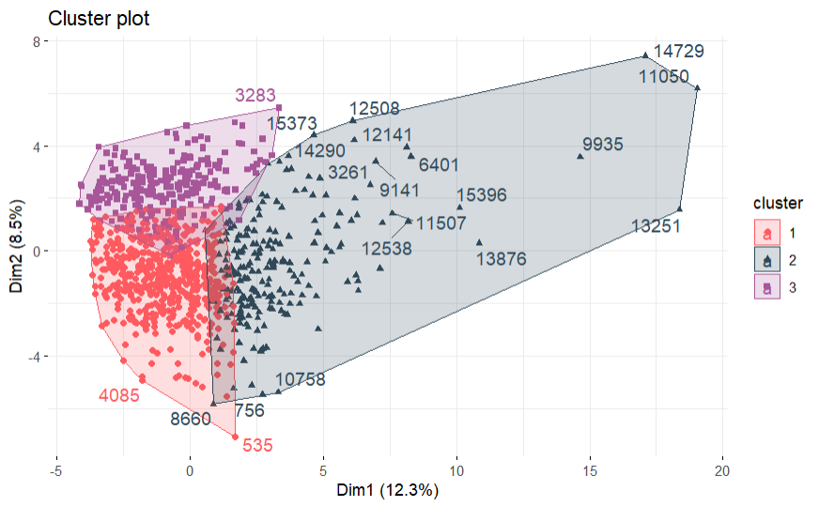
K-Means

Slide 6

Text Analysis
Language detection
Removing HTML code, punctuation, written accents and numbers
Removing English and Spanish stop words
Building a word frequency table
Apartment name and description
Neighborhood description
Host description

Slide 7
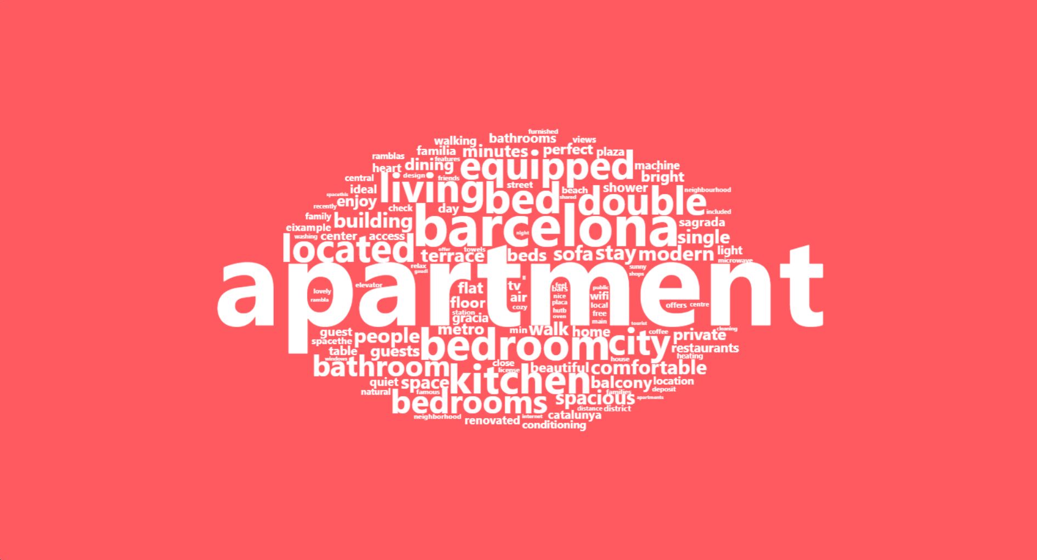
Word cloud of apartment descriptions

Slide 8
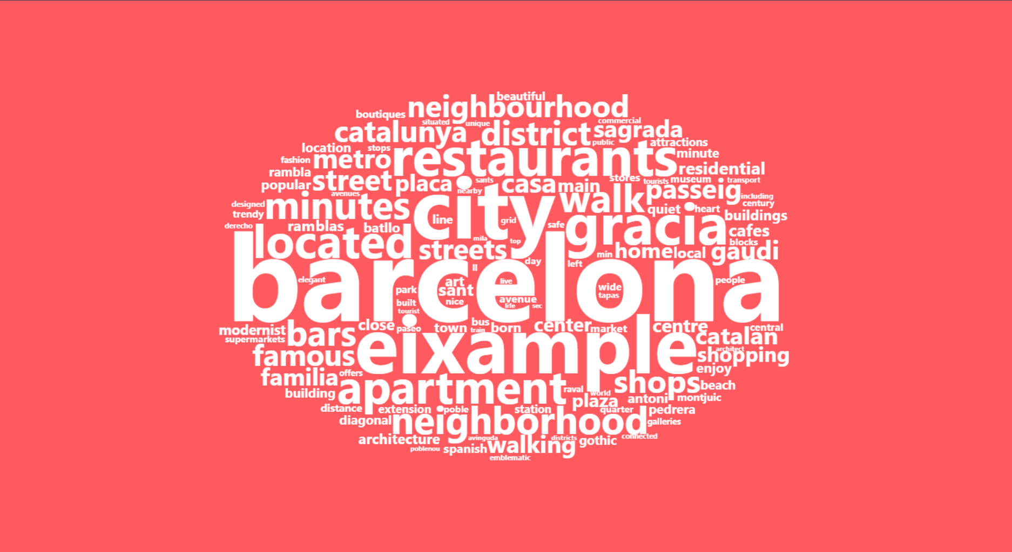
Word cloud of neighborhood descriptions

Slide 9
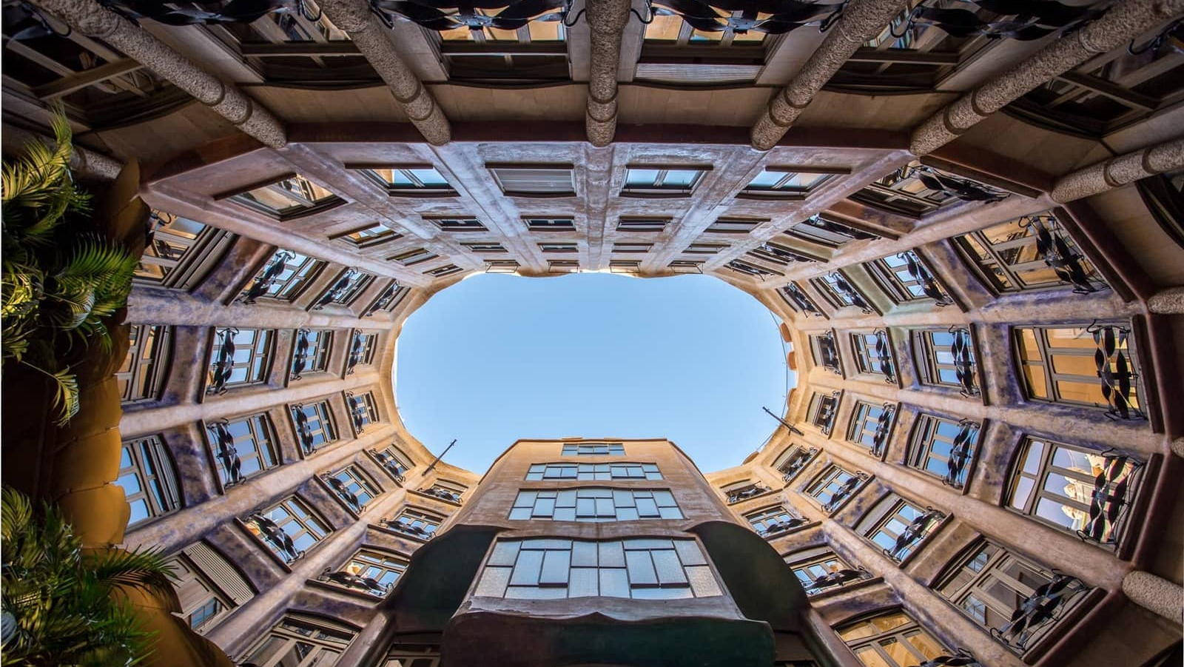
Incorporating AI
Full description
Discover the perfect city retreat in Barcelona with this spacious 1-bedroom apartment. The cozy bedroom features a comfortable double bed, while the well-equipped kitchen invites you to whip up culinary delights. Relax in the inviting living area or explore the vibrant city just outside your doorstep. With convenient amenities and a prime location, this apartment offers an ideal stay in Barcelona.
Words from descriptions
“apartment” | “barcelona” | “bedroom”
“bed” | “kitchen” | “living”
“located” | “double” | “equipped”
“city” | “bedrooms” | “bathroom”
“stay” | “spacious” | “building”

Slide 10




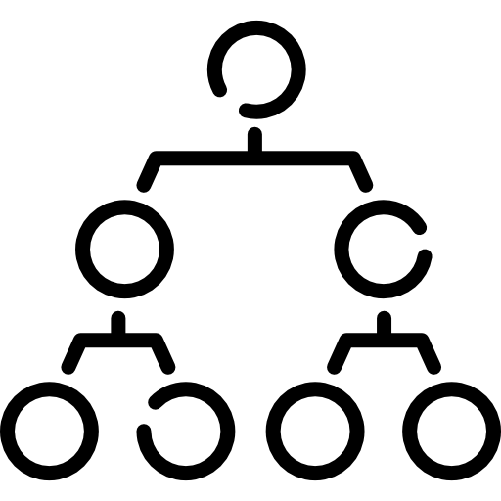

Supervised clustering
k-Nearest Neighbors
Support Vector Machines
Naive Bayes
42.75 %
72.86 %
73.47 %
Decision Trees
Random Forest
70.28 %
78.39 %

Slide 11
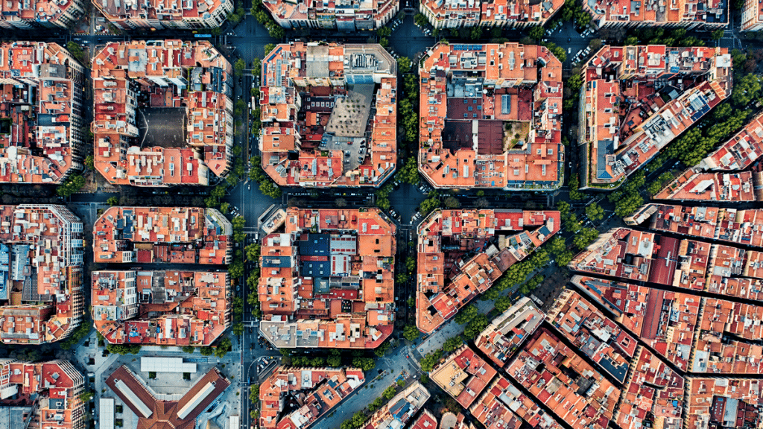
Other approaches
Neural
Network
Combining models
Using the amenities
Using all predictors
ReLu and Softmax functions | Random Forest + Naive Bayes | Random Forest | Random Forest
2 hidden layers | Combining them 98/2% | New set of data | Making the best possible model
69.15% accuracy | 78.77% accuracy | 69.03% accuracy | 79.29% accuracy

Slide 12
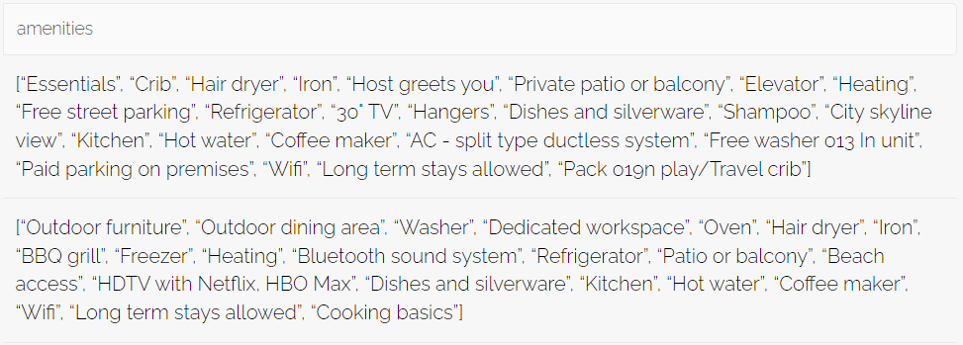
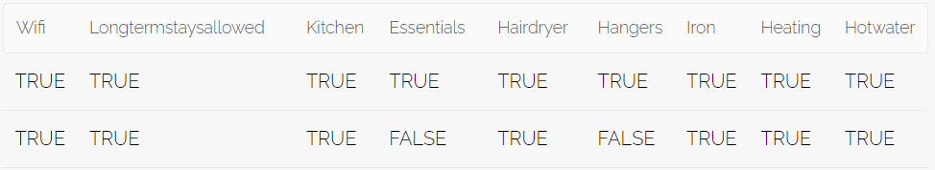
Random Forest using the amenities
Extract as list
Top 50 amenities
One-hot-encoding

Slide 13
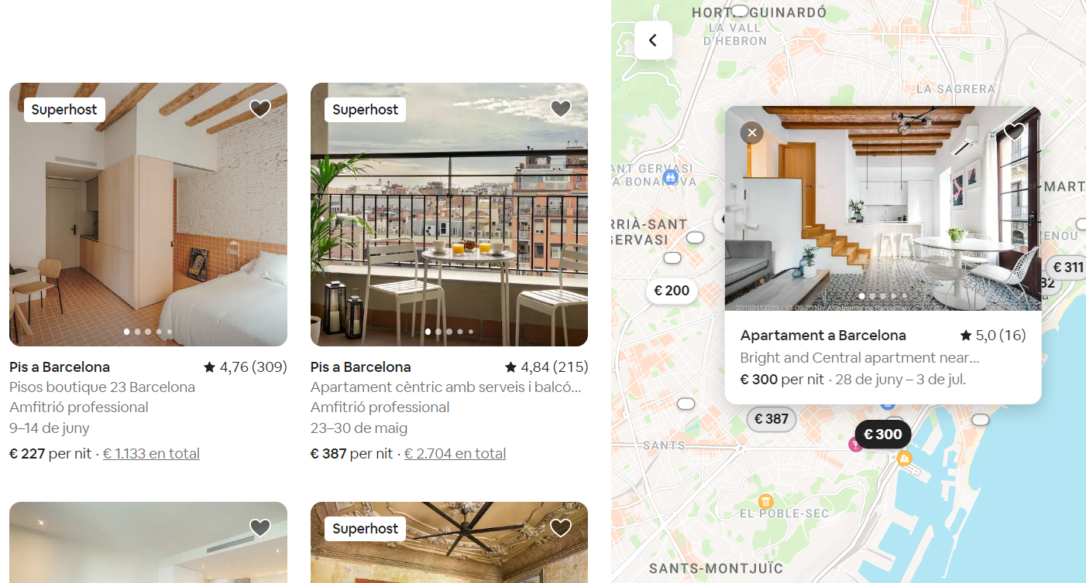

Real case: Predicting the price
Competitive price?

Slide 14
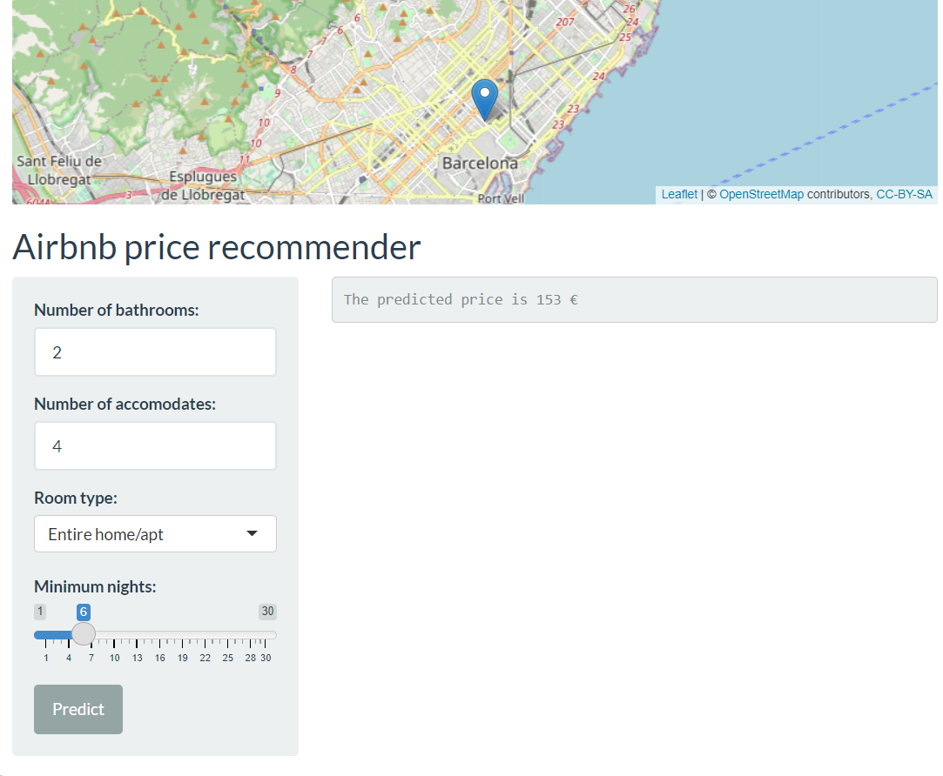
Random Forest (best approach when predicting the categorical price)
Designing a small Shiny App
Simplified version of the model

Slide 15
Thank you!

